Slide 1
Hi!

Slide 2
Goals
Reflect on math camp & course
Discuss what’s available at DCAL and why you should visit us
Talk about math and stereotype threat
Innovative math and science teaching methods
Resources

Slide 3
3-step interviews
In pairs, interview your partner (listen and take notes, but don’t respond):
What do you think was most successful in the math camps?
What didn’t work as well?
Switch interviewer and interviewee and repeat
Introduce each other and share answers with another pair; summarize successes and opportunities for improvement
Share with other group (and me!)
A summary B to C & D
B summary A to C & D
C summary D to A & B
D summary C to A & B
A interviews B
B interviews A
AB
CD

Slide 4
Snowball assessment
What worries you about the upcoming year?

Slide 5
Have you heard of DCAL before?
Yes
Sounds familiar
No

Slide 6
What does DCAL stand for?
Dartmouth College Athletic League
Dartmouth College Advocates for Learning
Dartmouth Center for the Advancement of Learning
Dartmouth Center for Advanced Learning

Slide 7
What does DCAL stand for?
Dartmouth College Athletic League
Dartmouth College Advocates for Learning
Dartmouth Center for the Advancement of Learning
Dartmouth Center for Advanced Learning

Slide 8
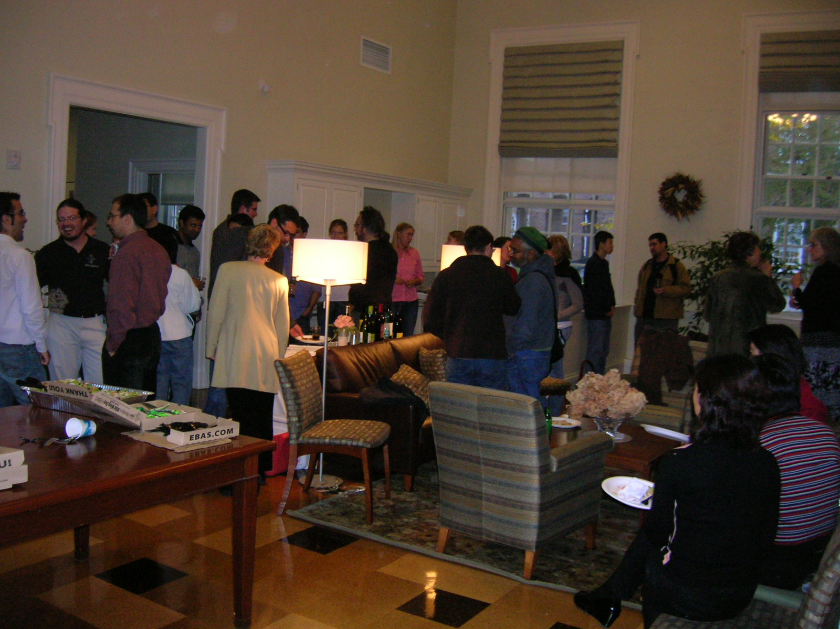
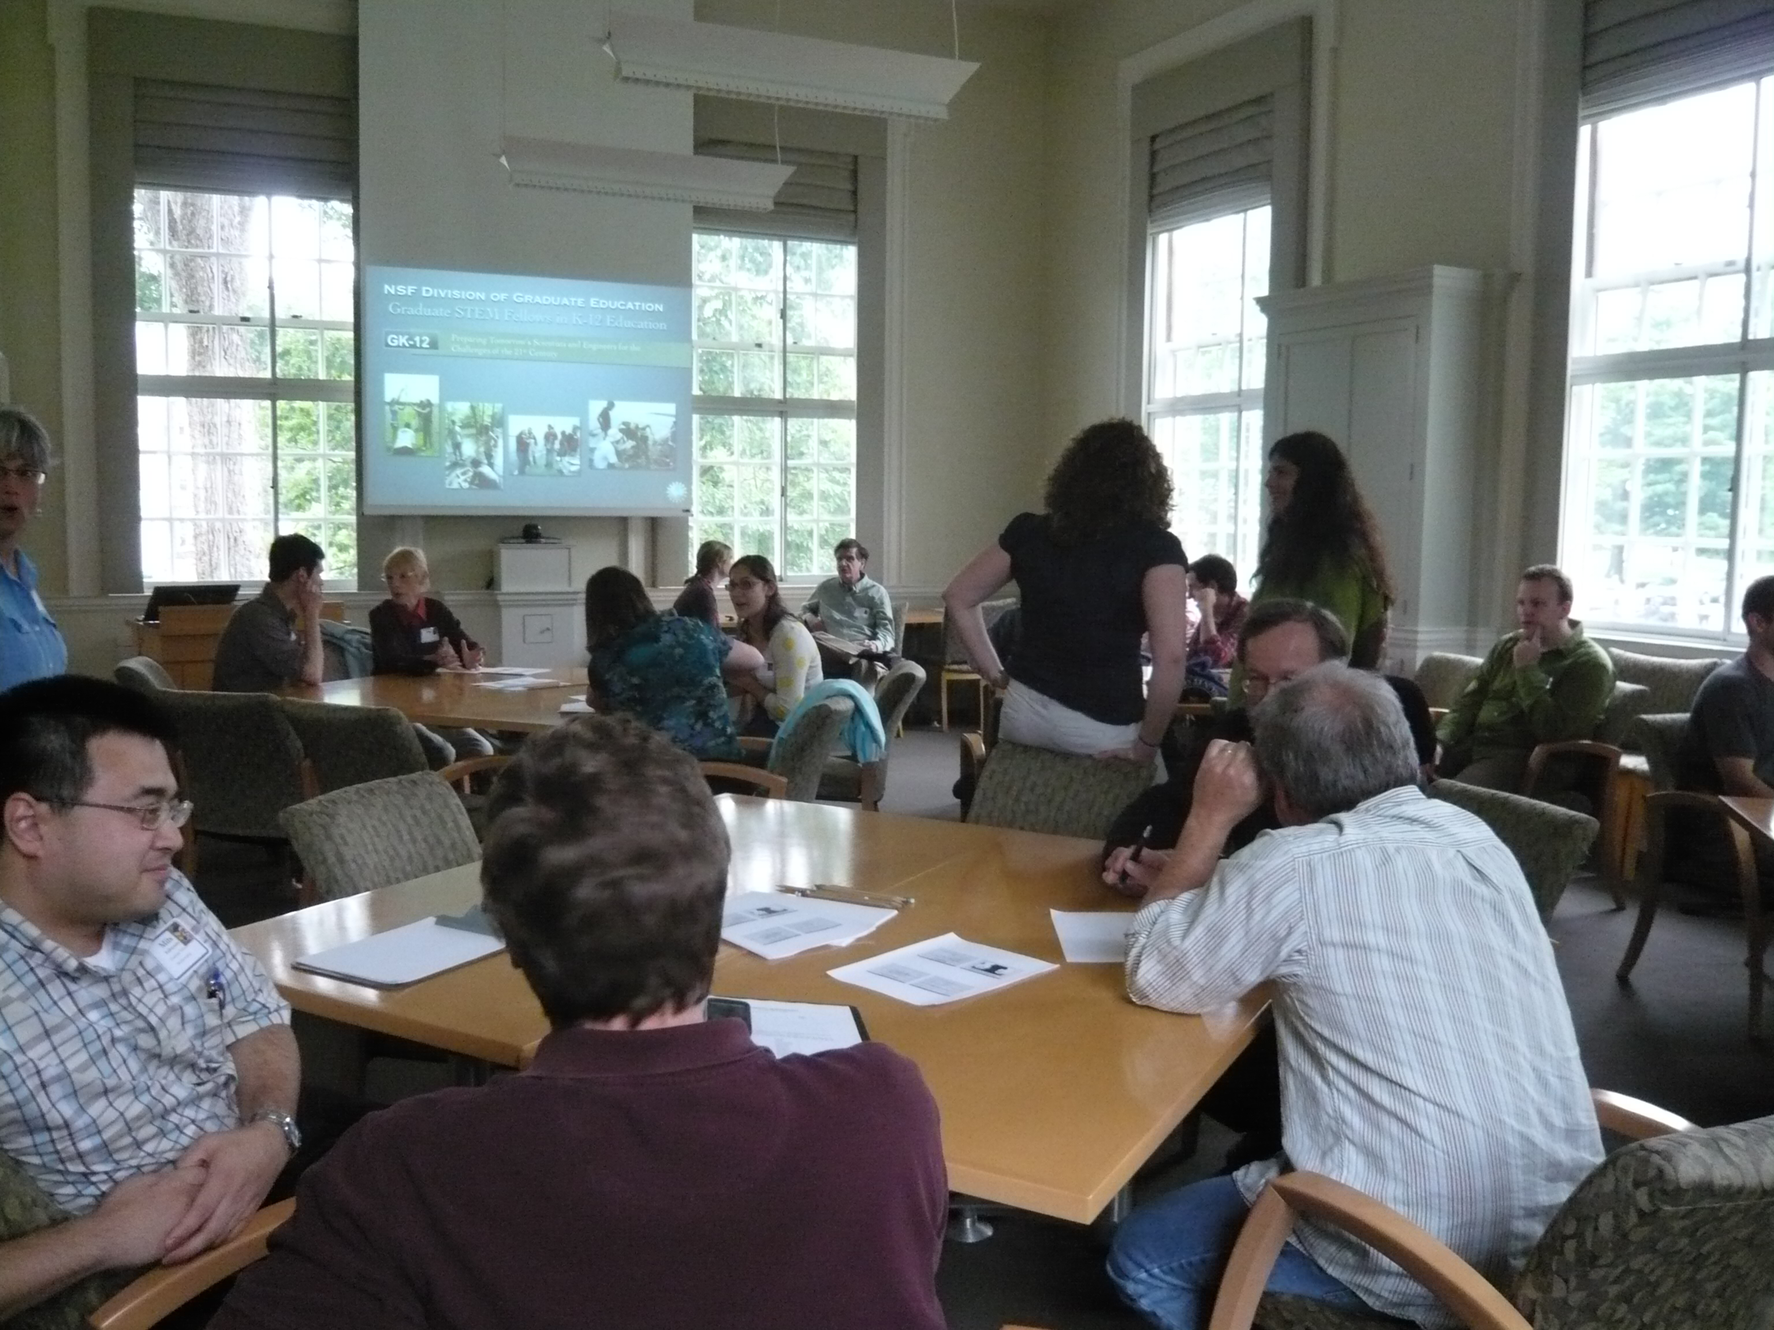
Where is DCAL located?
www.dartmouth.edu/~dcal

Slide 9
Teaching Science Seminar
??? will share some simple techniques to make interaction and discovery a key part of regular teaching. These include in-class worksheets, live demos, and “detective-style” homework - all of which boost the level of engagement, social interaction, and fun. There will be time for open brainstorming and sharing of ideas for successful interactive learning in the classroom.

Slide 10
Teaching Science Seminar
Colleagues from around campus will share their experiences with using high tech to create more effective learning environments. Topics include using tablet PCs as electronic blackboards in math (by ???), podcasting, and creating and using multimedia animations for science lectures.

Slide 11
Teaching Science Seminar
revision of medical school admission requirements and impact on offerings of several undergraduate departments
…attracting and retaining women and students of color as undergraduates majoring in STEM. We will examine successful comprehensive program elements from other institutions and will discuss departmental and institutional barriers to change and strategies…

Slide 12
Teaching with Blackboard Teaching with Technology (TWIT)
iPads
Clickers
Class blogs
Smart pens
Camtasia relay
Pre-course/class surveys
Mazur's Just-In-Time Teaching method
http://www.youtube.com/watch?v=lBYrKPoVFwg

Slide 13
Invited Speakers
Integrated Introductory Science at Princeton:
A Curriculum for Students
Interested in a Research Career
David Botstein has been instrumental in urging colleges and universities to re-organize the teaching of biology by integrating more mathematics and physical sciences into the biology curriculum. This presentation will provide an overview of the approach to this challenge he has led at Princeton.

Slide 14
Webinars
Why So Few?
Women in science, technology,
engineering, and mathematics
In an era when women are increasingly prominent in medicine, law, and business, why are there so few women scientists and engineers?
Drawing upon a large and diverse body of research, AAUW's report provides compelling evidence of environmental and social barriers--including gender bias, stereotypes, and the climate within college and university science and engineering departments--that continue to limit women's participation and progress.

Slide 15
Special Events
Cornell Interactive Theatre Ensemble
It depends on the lens
In this workshop, participants watch a DVD scenario of a search committee meeting about to choose the final candidates for its short list, then have the opportunity to ask two of the characters questions about the situation they have just witnessed.
This discussion is followed by a research talk on unconscious bias, describing the studies used to develop the interactions depicted in the scenario.

Slide 16
Future Faculty Programs
Future Faculty Teaching Series
Syllabus Design Workshop Series
Teaching Statement Workshops
Science Education Outreach
Dartmouth GK-12 Project
TA Workshop Series

Slide 17
Consultations
Future faculty
Current instructors
Assessment & instructional methods

Slide 18
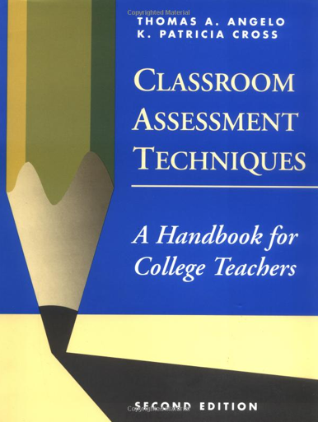
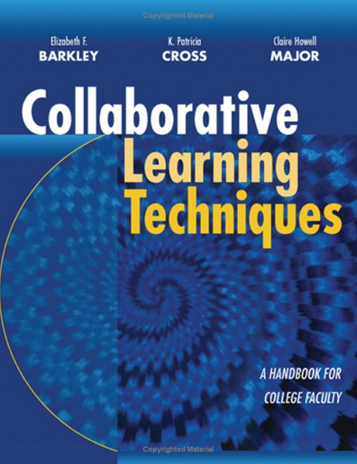

Slide 19
Your teaching (and student learning) is influenced by
Your perspectives resulting from an intersection of multiple social identities
Your experiences as a function of dynamics created by and resulting from membership in multiple social groups
What did you notice during math camp?
(or at Dartmouth or the Upper Valley or…?)
(slide based on Angela Byars-Winston, Aug 2003)

Slide 20
Under-Performance of Women In Math & Science
While outperforming men in all other areas of academia,
women earn less than 25% of the degrees in
Computer Science, Physics, and Engineering
College: women perform worse on standardized tests of mathematics but do well in their courses;
far fewer choose math/ hard science majors
Middle School: Girls earn equally high grades but begin to lose confidence in math abilities;
test score gap on standardized tests emerges
K-12: Girls Perform at or above the same level as boys on tests and in school; show less intrinsic interest in spatial tasks
(slide from Joshua Aaronson, Oct 2008)

Slide 21
(slide from S. Stroessner, May 2009)
Some Explanations for Achievement Gaps
Legacy of racism, prejudice and segregation (House, 1999; Spring, 2000)
Poverty and SES (Barton, 2003; Ferguson, 2001)
Cultural differences in language or in adaptation to school (Mercado, 2001;Ogbu, 1999, 2003; Portes, 1996, 1999)
Family and parenting (Eccles, 1994; McAdoo, 1978; Okagaki & Frensch, 1998)
Inequities in resources and opportunities to learn (Barton, 2003; Hanushek & Rivkin, 2006; Kozol, 1991; Mickelson, 2001)
Educators responses to student diversity (Delpit, 1996; Ferguson, 1998; Pollock, 2001; Spring, 2000)
Lack of role models (Dee, 2004, 2005)
Test bias (Airasian, 2001, Gould, 1981; Valencia & Suzuki, 2001)
Inherent differences in ability (Halpern, 1992; Summers, 2005)
Notes:
21

Slide 22
Stereotype Threat -> Identity Threat
Apprehension arising from the awareness of a negative stereotype or personal reputation in a situation where the stereotype or identity is relevant, and thus confirmable
everyone experiences this in some form
(slide from J. Aaronson, Oct 2008)

Slide 23
Examples of Identity Threat
Jewish person in the Bible Belt
African American Taking an IQ test
Woman called upon in math class
(slide from J. Aaronson, Oct 2008)
Notes:
An African American kid taking an IQ test, perhaps administered by a tester, feels wary that the test will reveal him to be as stupid or inferior as the stereotype alleges
A girl called upon in math class may feel extra pressure to not confirm the stereotype that relative to the boys, she’s not good at math
George W. Bush knows that lot’s of people doubt his intelligence; this may make public speaking

Slide 24
Stereotype Threat : No Explicit Bigotry Required
(slide from J. Aaronson, Oct 2008)

Slide 25
Math Test Performance Of College Men and Women (Spencer, Steele & Quinn, 1999)
(slide from J. Aaronson, Oct 2008)

Slide 26
When White Men Can’t Do Math Aronson, et al., (1999). Journal of Experimental Social Psychology.
d = .93
(slide from J. Aaronson, Oct 2008)

Slide 27
Educational Testing Service Study: Asking Gender Before AP Calculus Test
(slide from J. Aaronson, Oct 2008)
Notes:
Asking Gender Before AP Calculus Test Hurts Girls, Helps Boys

Slide 28
Advanced Level Women Outperform Advanced Men in Calculus When Threat Reduced
Field Study: Women in the Science Pipeline
Good, Aronson, & Harder (2008) Journal of Applied Developmental Psychology
(slide from J. Aaronson, Oct 2008)
Notes:
Highest Level College Calculus Students

Slide 29
Reducing Stereotype Threat in Middle School: A field Intervention
Question: Can psychological intervention raise test scores of minority students?
Method: mentoring study; attitude change
Conditions:
Malleability of intelligence
Role Models: senior students who stress the normality of early difficulty
Control (drug abuse message)
Measure: Texas Assessment of Academic Skills (TAAS)
(slide from J. Aaronson, Oct 2008)

Slide 30
7th Grade Girls’ Math TAAS
Good, Aronson & Inzlicht (2003) Journal of Applied Developmental Psychology.
(slide from J. Aaronson, Oct 2008)

Slide 31
Reducing Effects of Stereotype Threat: Strategies
De-emphasize ability & group identity; emphasize effort, persistence, individualism
Emphasize high standards and the ability of all to reach those standards
Stress the malleability of intelligence – “your brain is a muscle”
Provide exposure to Role Models
Show awareness of the external difficulties: Normalizing struggle
Groupwork that employs interdependence
(slide from J. Aaronson, Oct 2008
& S. Stroessner, May 2009)

Slide 32
Conclusion
Human intelligence, motivation, and academic self-concept is more fragile and malleable than traditionally thought. People’s performance and motivation can rise and fall depending on the situations and relationships they are in, and the mindsets they adopt.
(slide from J. Aaronson, Oct 2008)

Slide 33
References
http://reducingstereotypethreat.org/
http://www.msri.org/calendar/workshops/WorkshopInfo/458/show_workshop
http://www.trincoll.edu/depts/student-services/chas/
http://www.cirtl.net/diversityresources

