Slide 1
Math 10, Spring 2019 Introductory Statistics
Lecture 1
Controlled Experiments
and Observational Studies

Slide 2
Controlled Experiment
In a medical trial, compare the response of two groups:
Treatment group: receives treatment
Control group: receives no treatment, or receives placebo
The control group should be comparable to the treatment group
in all respects other than the treatment
(variables like: age, gender, health, …)

Slide 3
Treatment and Control groups
National Foundation for Infantile Paralysis (NFIP)
Polio vaccine trial of 1954
The numbers are rounded
Group | Size | Polio cases
Treatment group | 225,000 | 56
Control group | 725,000 | 391
Treatment group: Children in grade 2 were vaccinated
Control group: Children in grades 1 and 3 did not receive the vaccine
Remark: Parents of children in grade 2 may not consent to vaccination;
These children are excluded from the trial.

Slide 4
Compare rates, not absolute values
Group | Size | Polio cases | Rate per 100,000
Treatment group | 225,000 | 56 | 25
Control group | 725,000 | 391 | 54
Treatment group: 56 polio cases per 225,000
Percentage = 56 * 100% / 225,000 = 0.02488… % % = Rate per 100
Rate per 100,000 = 56 * 100,000 / 225,000 = 24.88…

Slide 5
Confounding
If the treatment and control group are not comparable with respect to some variable
and if that variable has an effect on the outcome of the experiment
then that variable is called a confounder.
A confounder is mixed up with the effect of treatment.

Slide 6
Confounding
Differences between treatment and control groups:
Treatment group: excludes children whose parents did not consent to vaccination
Control group: includes children whose parents would not have consented to treatment
confounder : “income level”
In 1954, higher income parents were more likely to give consent
lower income => lower hygiene => stronger immunity

Slide 7
Confounding
Differences between treatment and control groups:
Treatment group: grades 1 and 3
Control group: grades 2
Confounder: “grade level”
Polio is a contagious disease. Contagion spreads fastest between children in the same grade level.

Slide 8
Confounding
Group | Size | Polio cases | Rate per 100,000
Grade 2 (vaccine) | 225,000 | 56 | 25
Grades 1 and 3 (control) | 725,000 | 391 | 54
Grade 2 (no consent) | 125,000 | 55 | 44
Grade 2 (no consent): lower polio rate than control group
Even though neither group received the vaccine
This indicates confounding

Slide 9
Randomized Controlled Experiment
Optimal experimental design:
Assign subjects at random to treatment or control group.
This guarantees that the treatment group and control group are similar in all respects.
To prevent confounding: If parents would not consent to vaccination, do not include their children in the control group

Slide 10
Randomized Controlled Experiment

Slide 11
Double-blind experiment
Participants involved in the trial do not know whether they are in the treatment or the control group; for example, they may receive a placebo.
The evaluators observing the effect of treatment do not know who is in the treatment or the control group

Slide 12
Observational Study
Controlled Experiment: Investigator assigns subjects to treatment or control groups
Randomized Controlled Experiment: Subjects are assigned to treatment or control groups at random
Observational Study: Investigator can only observe or record, but cannot assign who is in which group
Example: “smokers” versus “non-smokers”

Slide 13
Observational Study
Observational studies may establish association between variables
Association is circumstantial evidence for causation
Major problem in observational studies:
Hard to rule out hidden confounders:
“What are possible relevant variables?”
The answer often depends on information from outside the study.
More art than science; Depends on human judgment.

Slide 14
Experiment or Observational Study?
Coronary Drug Project
Randomized, controlled double-blind experiment
Trial to evaluate drugs for prevention of heart attacks
Treatment group: 5,552 subjects randomly given one of 5 drugs
Control group: 2,789 subjects given placebo
Subjects are patients with heart-trouble

Slide 15
Experiment or Observational Study?
Control group: 21% died within 5 years
Treatment group for one of the drugs (clofibrate): 20% died within 5 yrs
Conclusion: Clofibrate is not effective?
Criticism: Many patients did not take their medicine
This is a possible explanation of the failure of treatment.

Slide 16
Experiment or Observational Study?
Comparing “adherers” to “non-adherers”
“Adherer” = patient who takes more than 80% of prescribed medicine
 | Number | Deaths | Rate
Adherers | 708 | 106 | 15 %
Non-adherers | 357 | 89 | 25 %
Total group *) | 1,103 | 220 | 20 %
*) Data on adherence missing for 38 subjects
Conclusion: Clofibrate is effective?

Slide 17
Observational Study!
Criticism
Investigator does not assign subjects to “adherers” or “non-adherers”
In controlled experiment: Investigator assigns subjects to groups
Comparison of “adherers” v. “non-adherers” is observational!
Are the two groups really comparable in all relevant ways?
Are there confounding factors?

Slide 18
Confounding
The difference between the groups is not due to the drug!
Clofibrate is not effective!

Slide 19
Confounding
Possible confounder:
“Adherers” are more concerned with their health
=> They take better care of themselves in general
=> That is why they lived longer
Association between adherence to treatment < = > response
is caused by a third variable (“life style”)

Slide 20
Controlling for confounding variables
Observational Studies: comparisons can be quite misleading
Try to “control” or “adjust” for confounding variables
How?
Compare smaller, more homogeneous groups:
similar in several potentially relevant variables
(gender, age, medical history, socio-economic factors, etc…)

Slide 21
Associations is not causation
Johns Hopkins hospital, Baltimore
Observational study found an association:
Babies exposed to ultrasound tend to have lower birthweight
The study adjusted for several confounding variables
ultrasound => cause ?? => lower birthweigth
Confounder:
problem pregnancies => ultrasound performed
Problem pregnancies => lower birthweight

Slide 22
Simpson’s Paradox
Graduate Division at UC Berkeley, 1973
“Is there a sex bias in graduate admissions?” (Science, vol. 187, 1975)
Gender | Applicants | Admitted | Rate
Men | 8,442 | 3,714 | 44%
Women | 4,321 | 1,512 | 35%
There was no evidence to suggest that men and women were not equally
qualified on the whole

Slide 23
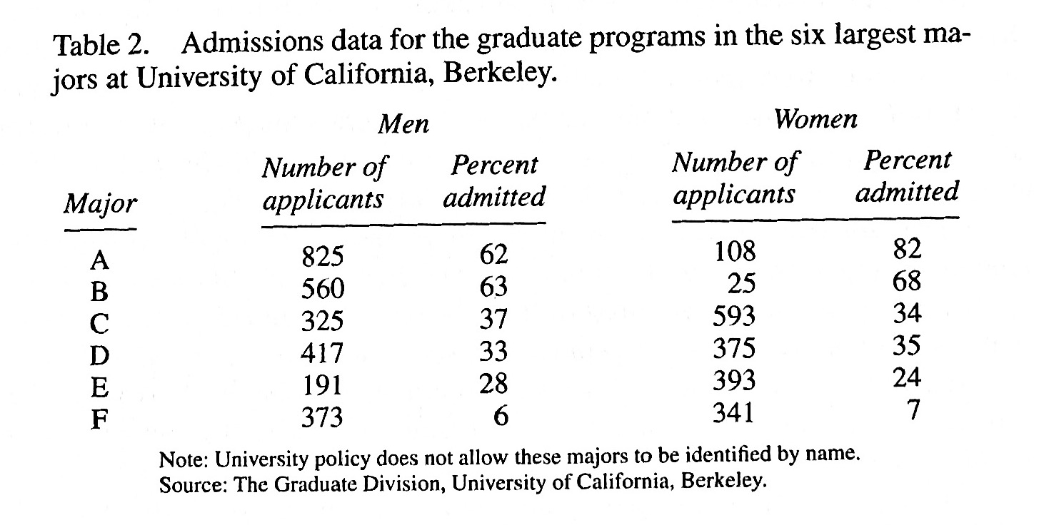
Simpson’s Paradox
Which majors discriminated most against women?

Slide 24
Simpson’s Paradox
The UC Berkeley graduate dean of admissions noticed
When looking at totals, it seems there is bias against women
When looking at majors, it seems there is bias in favor of women
This puzzle is called Simpson’s Paradox

Slide 25
Simpson’s Paradox
Resolution of the puzzle
52% of men applied to majors A, B
Majors A, B were easy to get into
93% of women applied to majors C, D, E, F
Majors C, D, E, F were hard to get into
Major | Admission Rate | Ratio of male applicants | Ratio of female applicants
A | 64 % | 31 % | 6 %
B | 63 % | 21 % | 1 %
C | 35 % | 12 % | 32 %
D | 34 % | 15 % | 20 %
E | 25 % | 7 % | 21 %
F | 6% | 14 % | 19 %
 |  | 100 % | 100 %

Slide 26
Simpson’s Paradox
Major | Men applied | Men admitted | Men admission rate | Women applied | Women admitted | Women admission rate
A, B | 1,385 | 865 | 62 % | 133 | 106 | 80 %
C, D, E, F | 1,306 | 333 | 25 % | 1,702 | 451 | 26 %
Total | 2,691 | 1,198 | 45 % | 1,835 | 557 | 30 %
Confounder: “choice of major” is mixed up with gender
as a predictor of chance of admission

Slide 27
Confounding
Freedman, Statistics, Fourth Edition, p. 20.
“Confounding means a difference between the treatment and control
groups – other than the treatment – which affects the responses being
studied.”
“A confounder is a third variable, associated with exposure and with
disease.”

