Slide 1
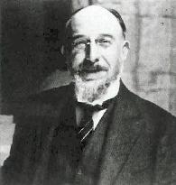
Erik Satie’s Gymnopèdie and the Acoustics of Piano Chords

Slide 2
Some Background on Gymnopèdie
Series of three piano compositions written by Satie, written the French composer in 1888.
Considered to be the forerunner of ambient music, and perhaps erroneously, furniture music.

Slide 3
Question:
While this piece certainly sounds very nice, is there any objective reason why?

Slide 4
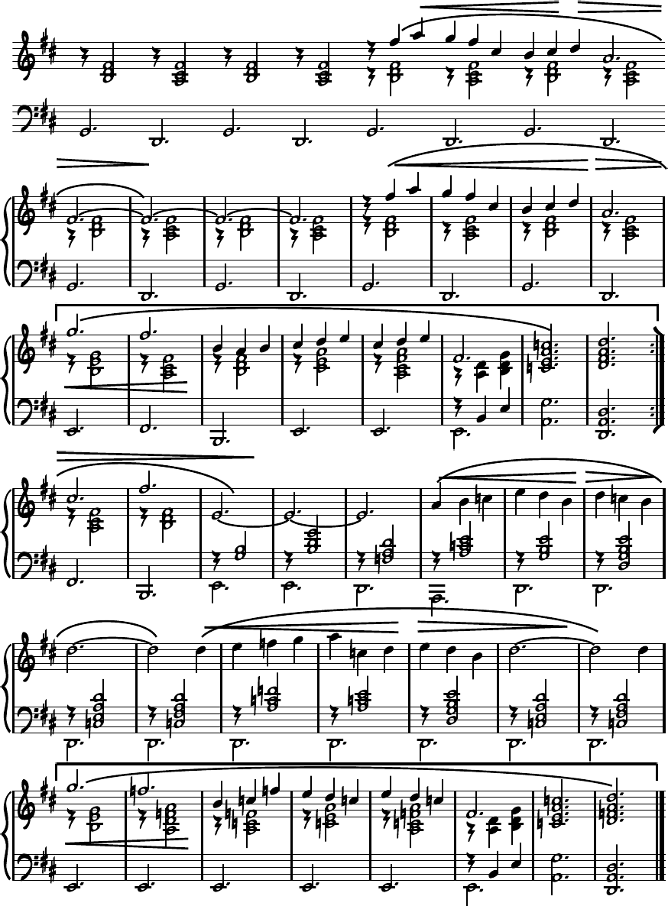
Opening Chords
The piece begins with a pair of alternating major seventh chords. The first and third chords are based of a root of G (in this case G2). Meanwhile, the second fourth chords have D (specifically, D2) as a root.

Slide 5
Frequencies that should be present (below 1000 Hz):
Root on G
Root on D
Har-monic (Hz): | Pitch: G2 | B3 | D4 | F#4
1 | 98 | 247 | 293.7 | 370
2 | 196 | 494 | 587.4 | 740
3 | 294 | 741 | 881.1 | -
4 | 392 | 988 | - | -
5 | 490 | - | - | -
6 | 588 | - | - | -
7 | 686 | - | - | -
8 | 784 | - | - | -
9 | 882 | - | - | -
Har-monic(Hz): | Pitch: D2 | A3 | C#4 | F#4
1 | 73.4 | 220 | 277.2 | 370
2 | 146.8 | 440 | 554.4 | 740
3 | 220.2 | 660 | 831.6 | -
4 | 293.6 | 880 | - | -
5 | 367 | - | - | -
6 | 440.4 | - | - | -
7 | 513.8 | - | - | -
8 | 587.2 | - | - | -
9 | 660.6 | - | - | -

Slide 6
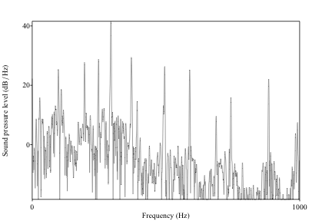
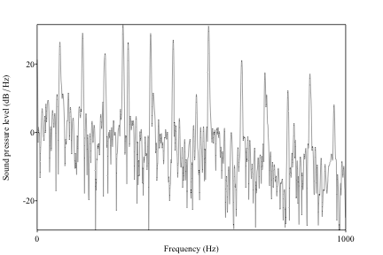
Root G Root D

Slide 7
The Actual Numbers:
Root G
Root D
Har-monic (Hz): | Pitch:G2 | B3 | D4 | F#4
1 | 98 | 247.6 | 293.8 | 371
2 | 195.9 | 495 | 588.8 | 735.8
3 | 295.9 | 742.5 | 885.6 | -
4 | 392.6 | 990.8 | - | -
5 | 490.4 | - | - | -
6 | 589.2 | - | - | -
7 | 686.2 | - | - | -
8 | - | - | - | -
9 | - | - | - | -
Har-monic (Hz): | Pitch:D2 | A3 | C#4 | F#4
1 | 74 | 220.2 | 277.7 | 376.7
2 | 146.7 | 439.9 | 556.8 | 735.8
3 | 213.6 | 662.4 | 883.1 | -
4 | 294.7 | 884.1 | - | -
5 | 368.2 | - | - | -
6 | 440.8 | - | - | -
7 | 516.8 | - | - | -
8 |  | - | - | -
9 | - | - | - | -

Slide 8
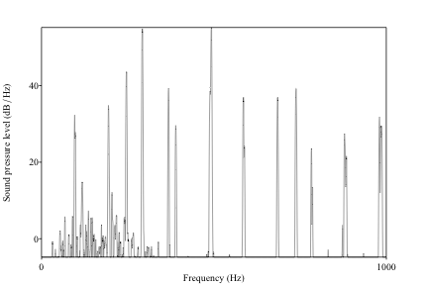
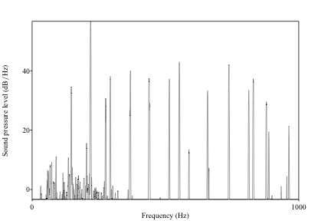
Root G Root D

Slide 9
Results from my playing:
Root of G
Root of D
Har-monic (Hz): | Pitch:G2 | B3 | D4 | F#4
1 | 96.2 | 246.7 | 292.9 | 367.7
2 | 194.1 | 493.2 | 589.2 | 737
3 | 291.4 | 737 | 878.2 | -
4 | 388.9 | 984.3 | - | -
5 | 490.4 | - | - | -
6 | 588.3 | - | - | -
7 | 684.3 | - | - | -
8 | - | - | - | -
9 | - | - | - | -
Har-monic (Hz): | Pitch:D2 | A3 | C#4 | F#4
1 | 74.1 | 220.3 | 277.9 | 376.9
2 | 146.9 | 439.6 | 557.7 | 736.2
3 | 214.1 | 663.1 | 883.8 | -
4 | 294.9 | 884.9 | - | -
5 | 368.6 | - | - | -
6 | 439.9 | - | - | -
7 | 517.2 | - | - | -
8 |  | - | - | -
9 | - | - | - | -

Slide 10
Why Don’t Harmonics Line-Up?:
The Answer lies in the instrument itself: Inharmonicity results from the piano creating stretched partials.
However, as Harvey Fletcher proposed, these partials are also responsible for giving the piano its distinctive sound.

