Slide 1
Spatial Statistics: Lung Cancer Distributions in NH
Sam Barrett, Erika Ogino, Sruthi Pasupuleti, Zach Segal
Notes:
Zach

Slide 2
Lung Cancer Distributions in NH
Lung cancer occurences- How does NH stack up?
Presentation of given data
Bivariate normal density
Normalization of data
Cancer Hotspots
Possible causes
Notes:
Zach

Slide 3
Lung Cancer Distributions in NH
Lung cancer occurences- How does NH stack up?
Presentation of given data
Bivariate normal density
Normalization of data
Cancer Hotspots
Possible causes
Notes:
Zach

Slide 4
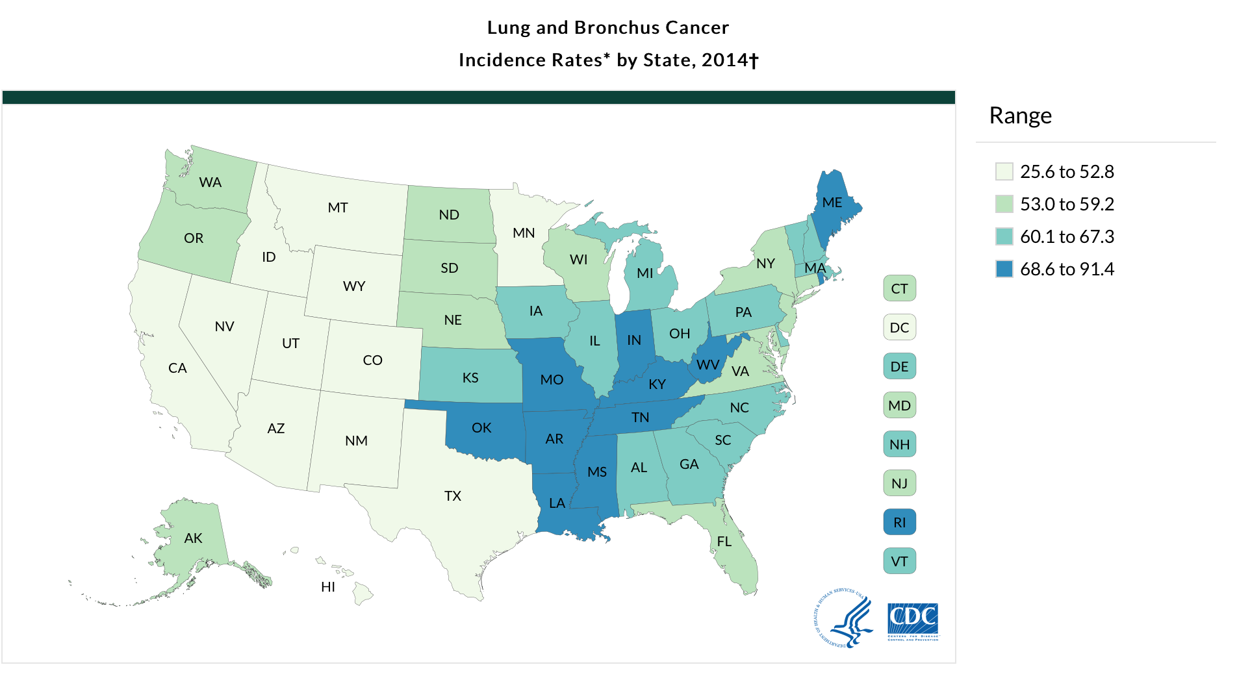
*Rates are per 100,000 and are age-adjusted to the 2000 U.S. standard population.
Notes:
Zach

Slide 5
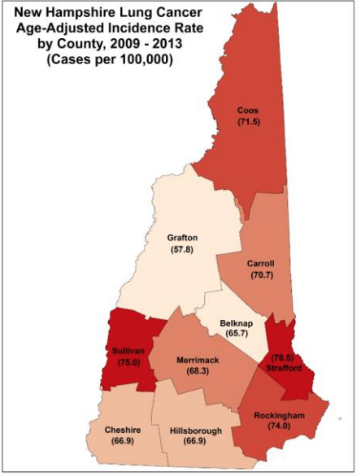
Notes:
Zach

Slide 6
Lung Cancer Distributions in NH
Lung cancer occurences- How does NH stack up?
Presentation of given data
Bivariate normal density
Normalization of data
Cancer Hotspots
Possible causes
Notes:
Sruthi

Slide 7
Data Given
Coordinates of 259 NH towns
Coordinates of 10,439 lung cancer occurrences
Population of NH towns
Coordinates of randomly chosen 34,728 NH residents
Notes:
Sruthi

Slide 8
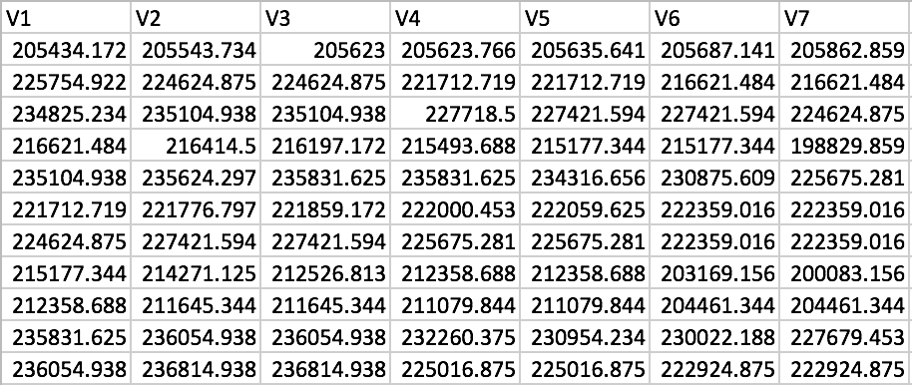
NHtowns.csv: Coordinates of 259 Towns
Notes:
Sruthi

Slide 9
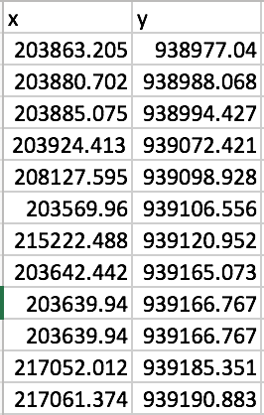
xyNHcancer.csv: Coordinates of 10,439 Lung Cancer Occurrences
Notes:
Sruthi

Slide 10
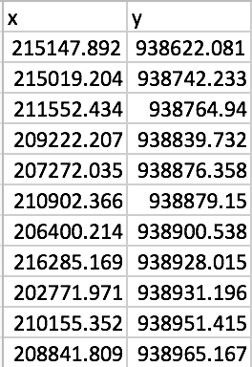
xyNHpopulation.csv: Location of Randomly Chosen 34,728 Residents
Notes:
Sruthi

Slide 11
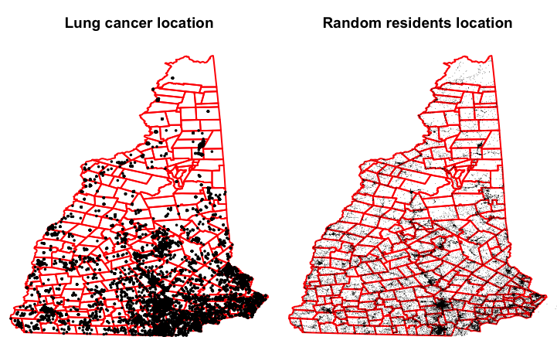
Lung Cancer Incidence Graph in New Hampshire does not show Cancer Rate
Lung cancer is more common in areas with higher populations (southern NH)
A high incidence of lung cancer in a location does not mean this location has a higher cancer rate - high incidence can be driven by high population
Notes:
Sruthi

Slide 12
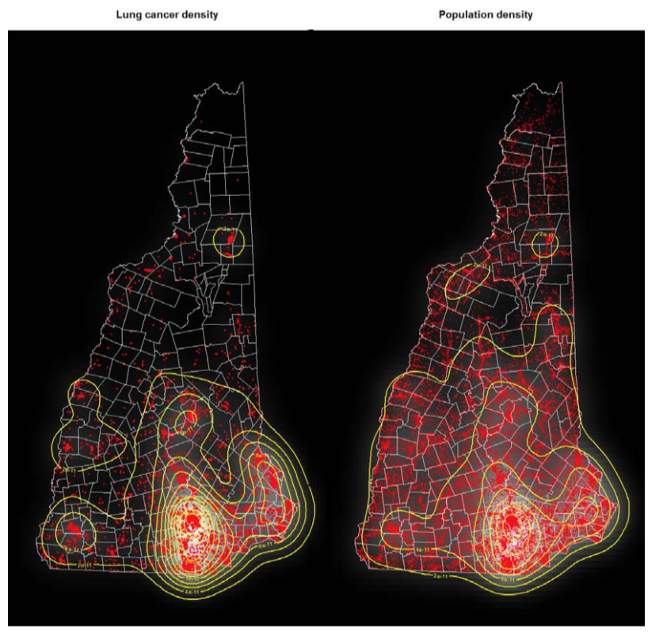
Gaussian Kernel Densities for Lung Cancer Incidence and Population in NH
Both densities peak in the same locations (for example in southern NH).
High lung cancer incidence can be driven by a high population and does not reflect a necessarily high cancer rate.
Notes:
Sruthi

Slide 13
Lung Cancer Distributions in NH
Lung cancer occurences- How does NH stack up?
Presentation of given data
Bivariate normal density
Normalization of data
Cancer Hotspots
Possible causes
Notes:
Erika

Slide 14
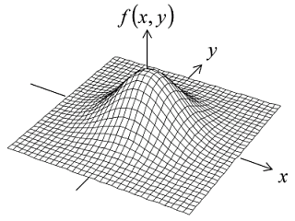
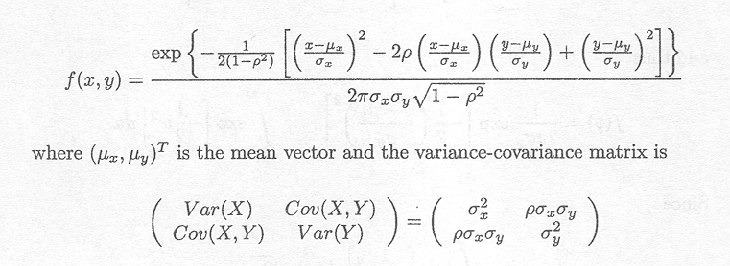
Introduction to Bivariate Normal Density
Studied by famous mathematicians such as Gauss, Laplace, Plana and Bravais in 19th century
First studied in depth by Francis Galton (1822-1911) during study of heights of parents and children
Two variables, both normally distributed
Notes:
Erika
X and Y are geographic coordinates, and Z is the population or cancer density
The two variables in a bivariate normal are both are normally distributed, and they have a normal distribution when both are added together. Visually, the bivariate normal distribution is a three-dimensional bell curve.

Slide 15
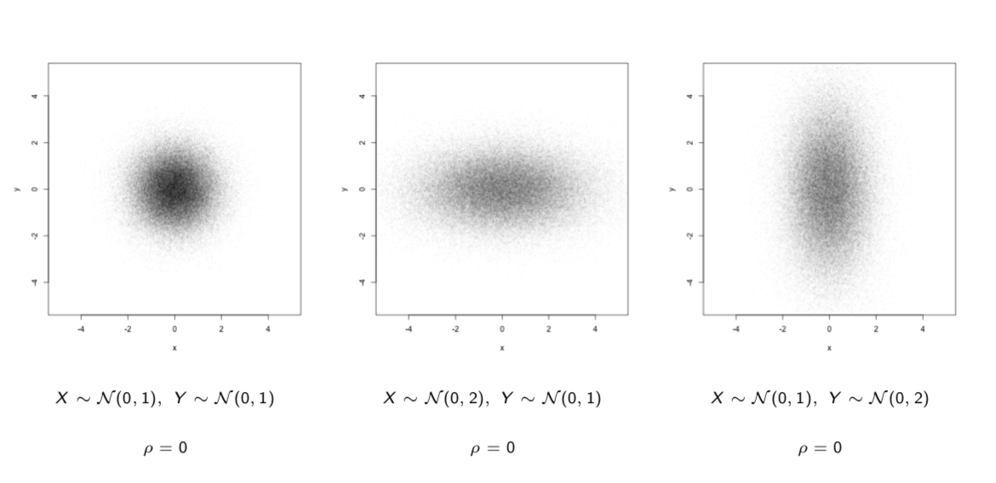
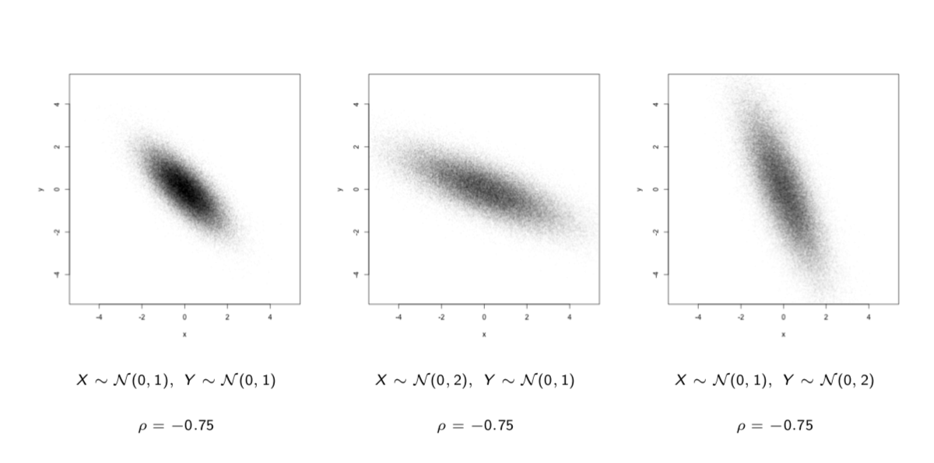
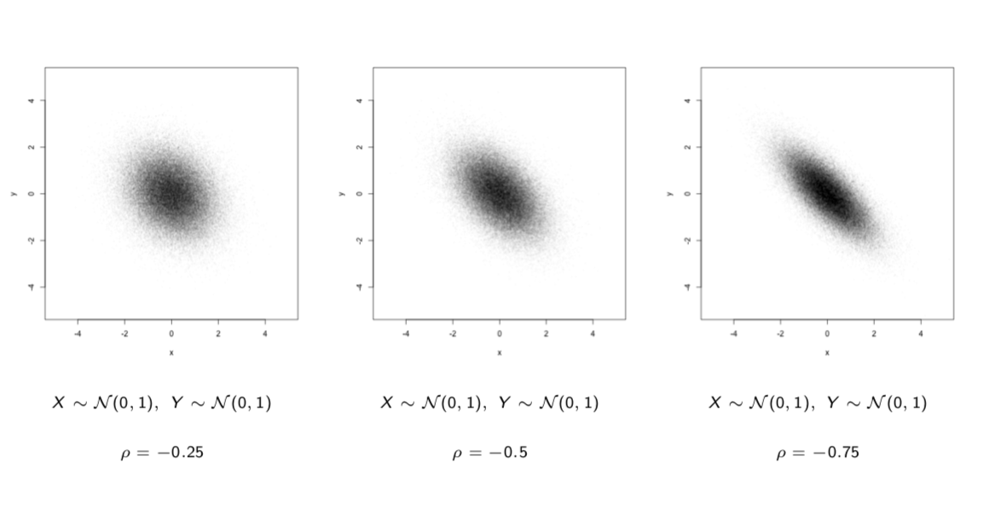
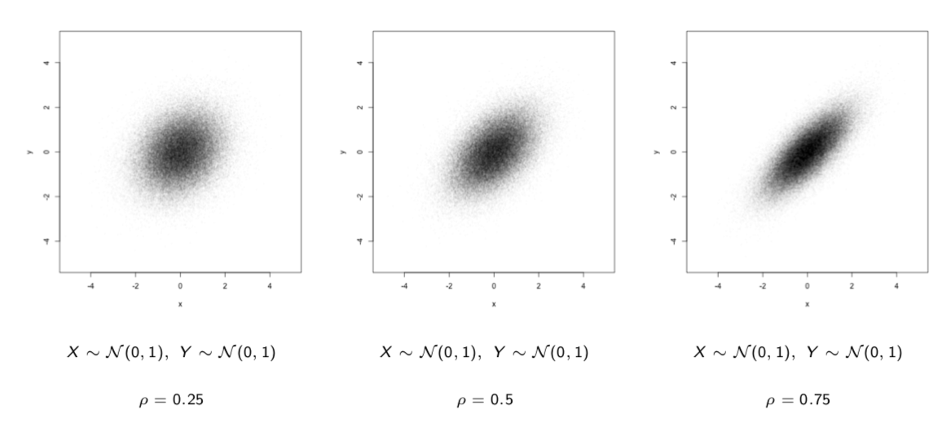
Bivariate Normal Density- examples
Notes:
Erika
https://www2.stat.duke.edu/courses/Spring12/sta104.1/Lectures/Lec22.pdf

Slide 16
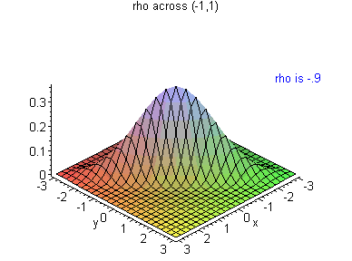
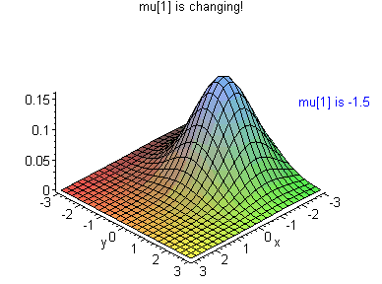
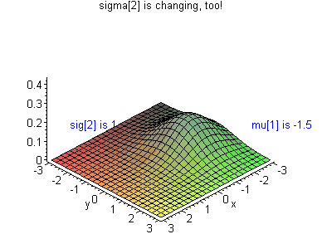
Notes:
Erika
http://personal.kenyon.edu/hartlaub/MellonProject/Bivariate2.html

Slide 17
Lung Cancer Distributions in NH
Lung cancer occurences- How does NH stack up?
Presentation of given data
Bivariate normal density
Normalization of data
Cancer Hotspots
Possible causes
Notes:
Sam

Slide 18
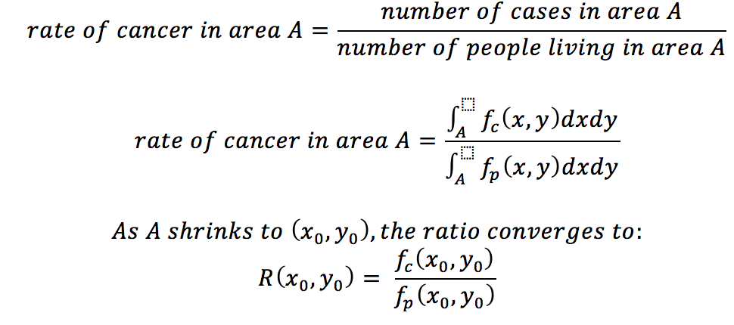
To Calculate Cancer Rate we need the Per/Capita Density
Notes:
Sam

Slide 19
Lung Cancer Distributions in NH
Lung cancer occurences- How does NH stack up?
Presentation of given data
Bivariate normal density
Normalization of data
Cancer Hotspots
Possible causes
Notes:
Sam

Slide 20
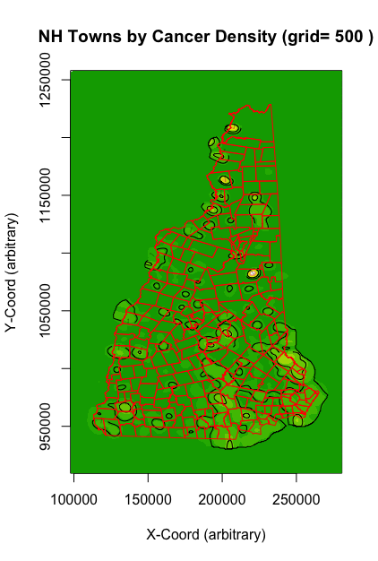
Raw Per-Capita
Heat Map
Generated via division of “density grids”
As shown, densities plotted on arbitrary/relative scale (volume under curve not equal zero)
Three notable peaks in rural towns
Bartlett
Stratford
Pittsburg
Key takeaway: high-population urban areas no longer highest-density areas
Notes:
Sam

Slide 21
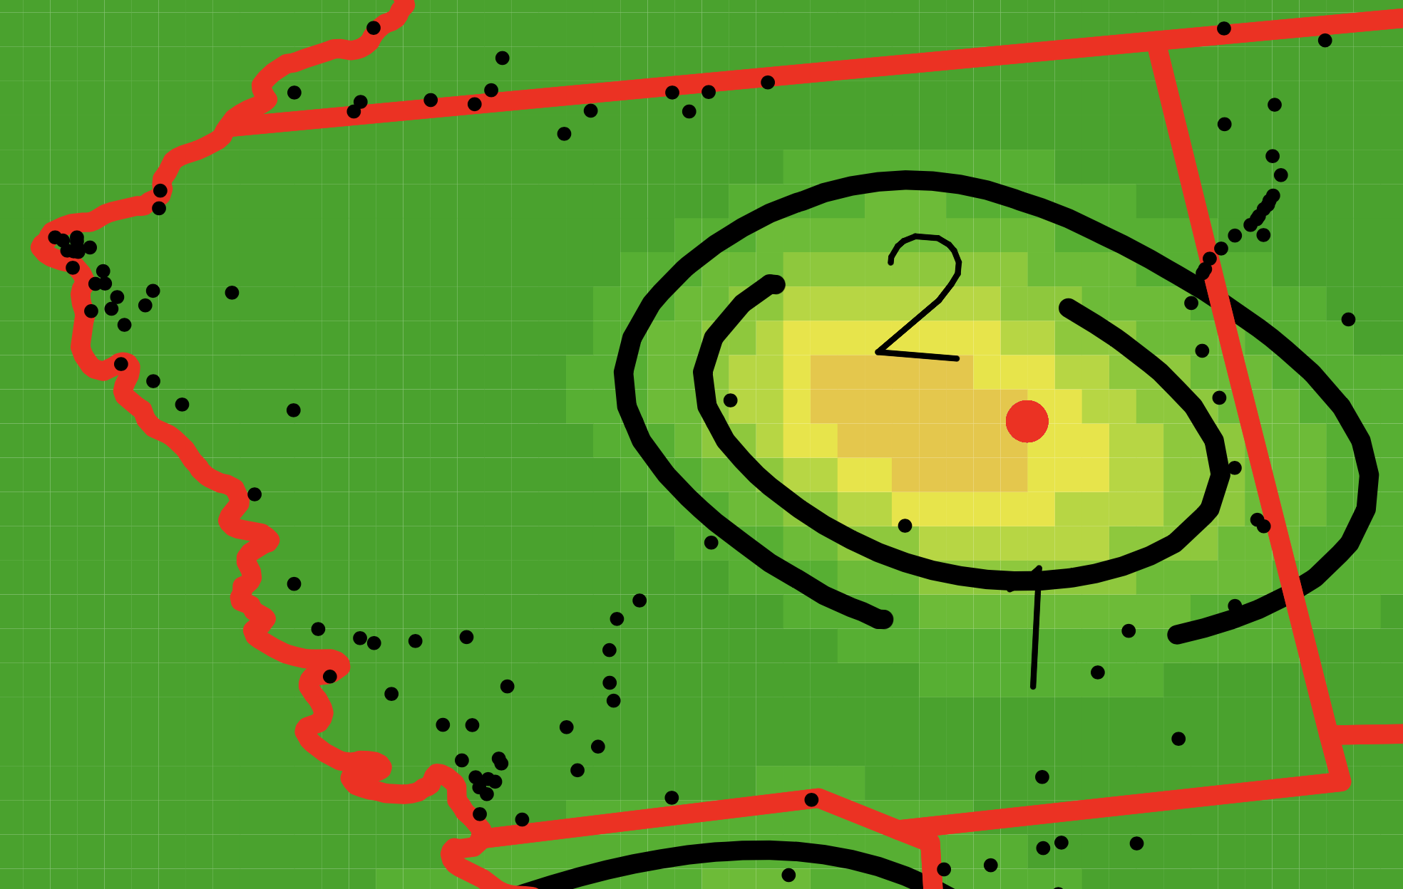
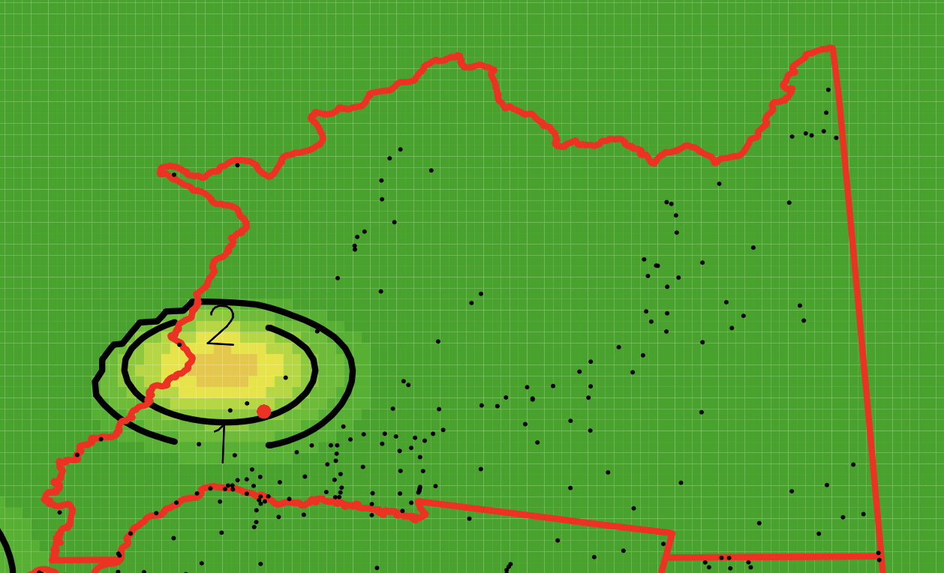
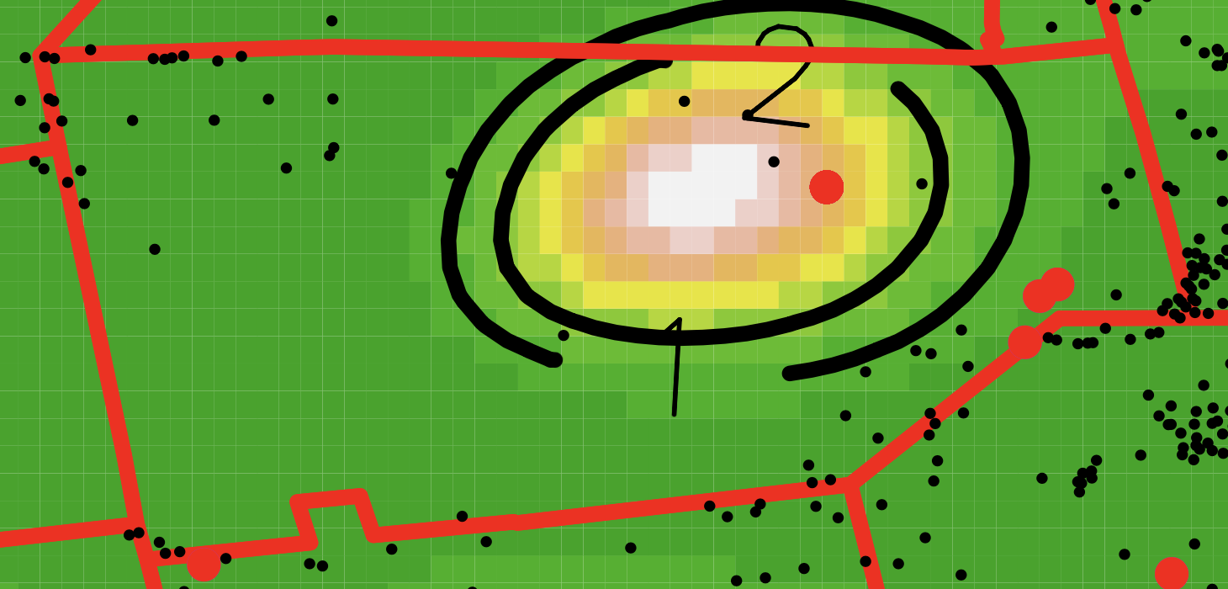
Are we in need of a rescale?
Town of Stratford
Town of Pittsburg
Town of Bartlett
A common thread between these peaks?
Yes! Density is high not because of many cancer occurrences, but because of low population!
Notes:
Sam

Slide 22
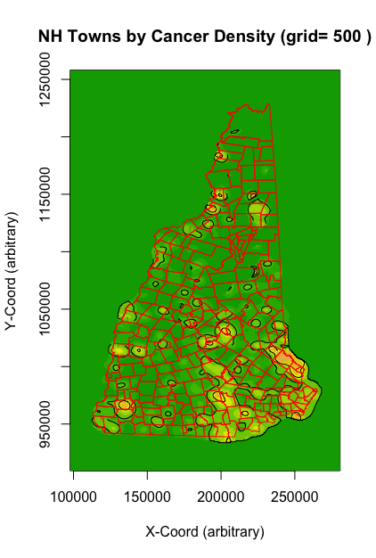
Low-Population “Trimmed” Heat Map
Increased necessary population density for plotting by one order of magnitude (10x)
Isolated peaks in rural areas largely gone
New points of interest: large suburban/urban regions in SE New Hampshire (Strafford County and the Manchester-Nashua belt)
Notes:
Sam (NOTE: I DELETED THE “CANCER HOTSPOTS” SLIDE (seemed redundant given what we already have)

Slide 23
Potential Model Issues/Limitations
Plotted density valid for visual analysis/comparison but not rigorous inference
Result of theoretically improper scaling
Low-population “rescale” causes non-Gaussian contours
Correlation between cancer rates and locational attributes not a necessary indicator of causality
Time series data would be useful!
Incomplete initial data sets may have created imperfect density estimations.
Can’t be sure of true lung cancer/population distributions over an area without an initial data set including all individuals and all lung cancer cases
Notes:
Sam

Slide 24
Hanover Data
Average NH Data
Median Age:
Median Household Income:
Population Size:
22
$96,000
8,482(6,300 Students)
42.7
$70,936
Total population 1.3M
Notes:
Zach

Slide 25
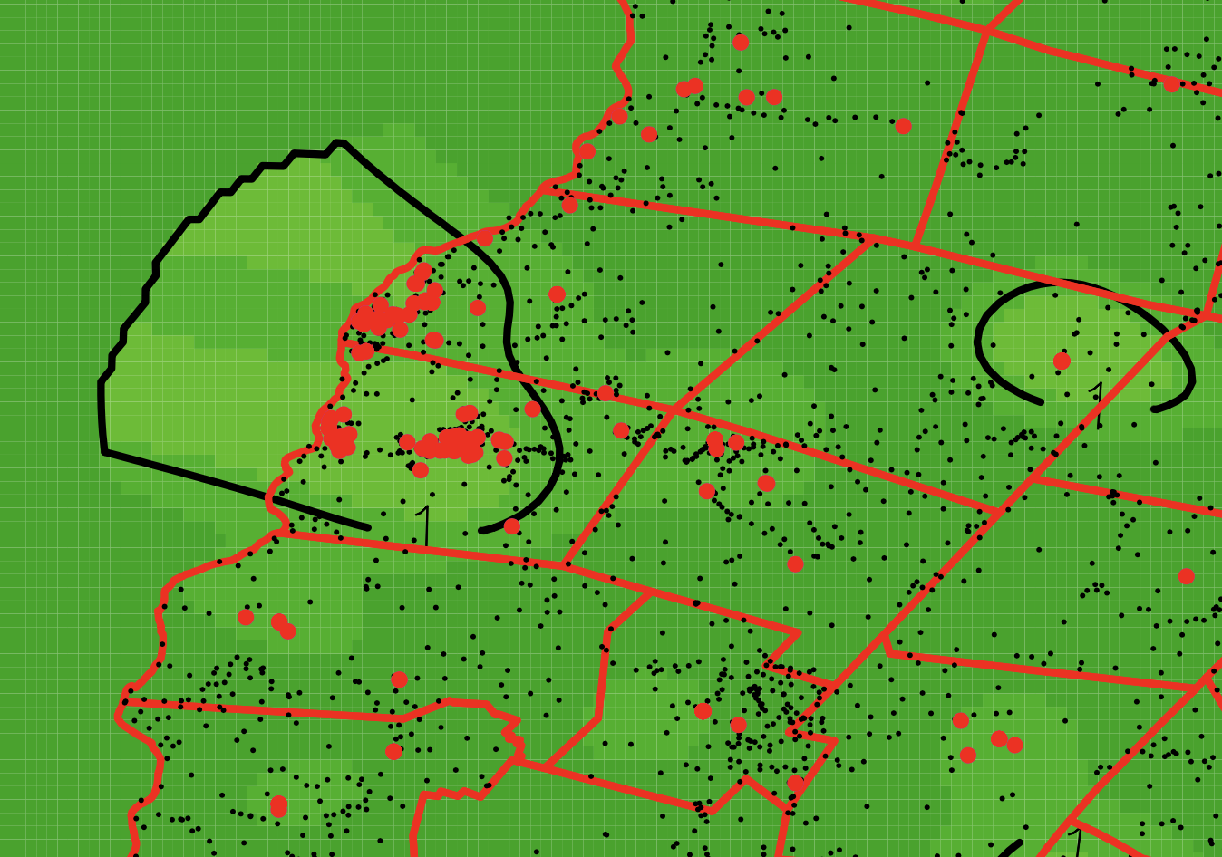
Lung Cancer around Dartmouth
Hanover/Lebanon display high per-capita cancer rates relative to immediate vicinity but not relative to the state altogether
Potentially indicative of higher individual cancer risk in more developed/populated areas
Notes:
Zach

Slide 26
Lung Cancer Distributions in NH
Lung cancer occurences- How does NH stack up?
Presentation of given data
Bivariate normal density
Normalization of data
Cancer Hotspots
Possible causes
Notes:
Erika

Slide 27
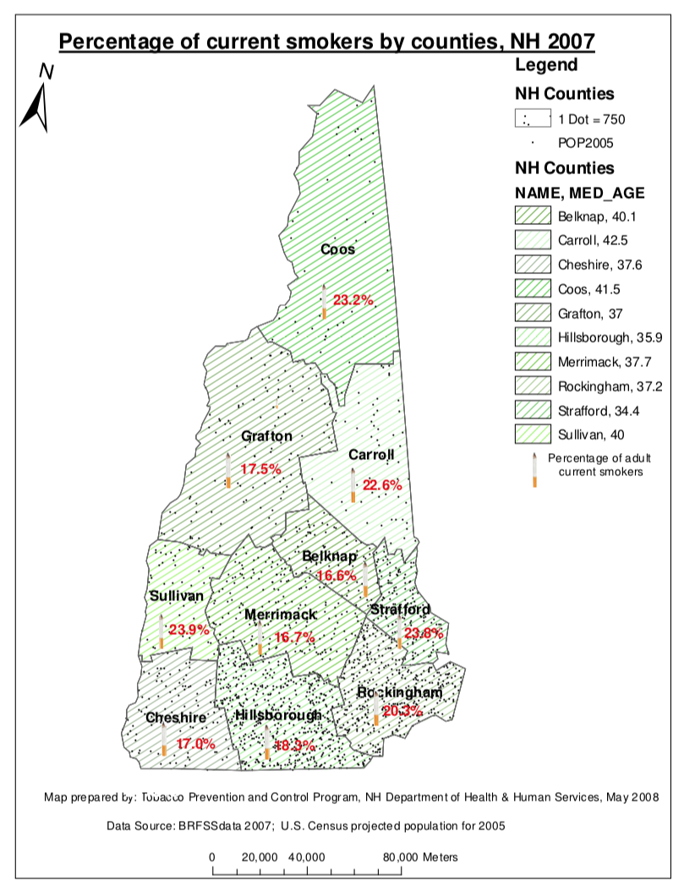
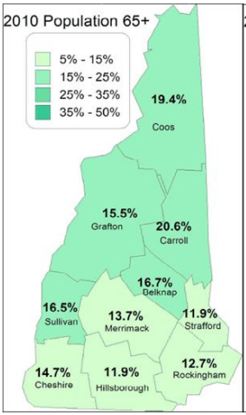
Notes:
Erika
Risk Factors of Lung Cancer
Smoking
Radon
Age
Asbestos
arsenic
Income related factors
Other factors

Slide 28
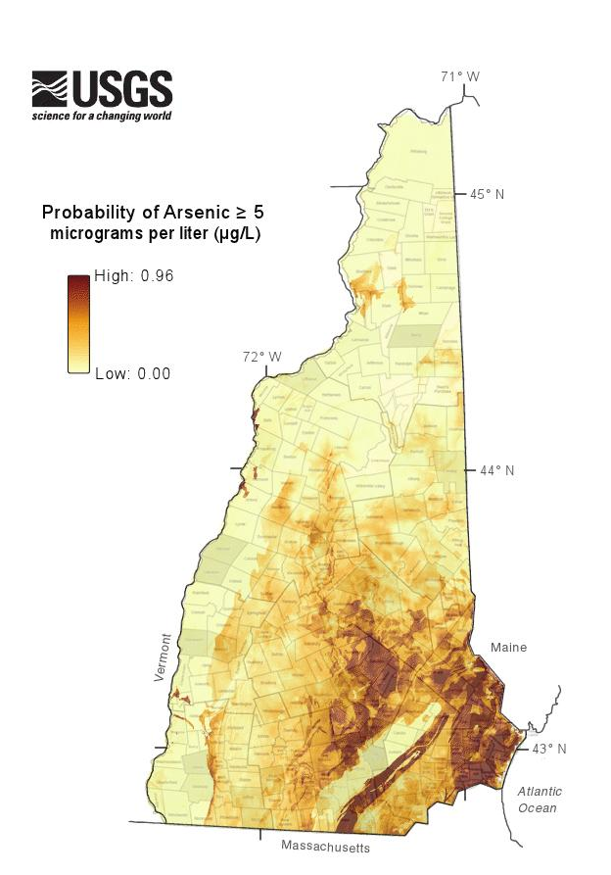
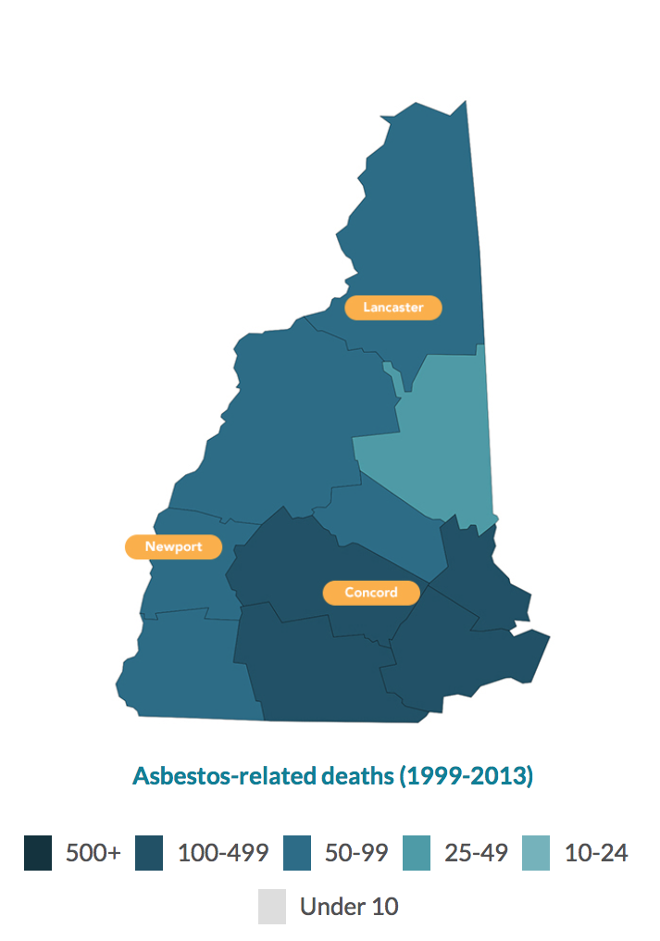
Notes:
Sruthi
Environmental toxins

Slide 29
Concluding Thoughts
This method works well to asses similar data
Both random sampling of population and empirical density plots help make trends apparent
Taking a percent of the population randomly lets you represent population with fewer data points
Some data cannot be modeled with density functions but empirical density plots let you see data
Notes:
Sruthi

Slide 30
“Mathematics is the Queen, Statistics is the King”
Thank you Professor Demidenko!
- Professor Demidenko
Notes:
Zach

